Slide 1
Bottom-up Data Analysis
An Example

Slide 2
Rigorous, bottom-up, data analysis
Bottom-up data analysis is used as a method of database design when an enterprise already has an information system, but one which needs to be refined before it can be implemented as a relational database
It uses the techniques we have met

Slide 3
Outline
Systems analyst obtains a copy of every
  document
  screen display
  report
  record card
  ...
… or any other tangible information source relevant to the information system that is being designed
These sources are processed according to a well defined procedure, to produce a suitable collection of relation schemas

Slide 4
The Procedure
(to be followed for every information source)
represent the source as an un-normalised structure
normalise that structure
  splitting as necessary
check that all relations are in normal form
  repeating as necessary
optimise the whole set of normalised relations

Slide 5
Normalisation
Remember ...
  normalisation means a separation of concerns
    often eliminates redundancy in the relations
  there are various normal forms
    choose an acceptable one
    3NF
    (BCNF)

Slide 6
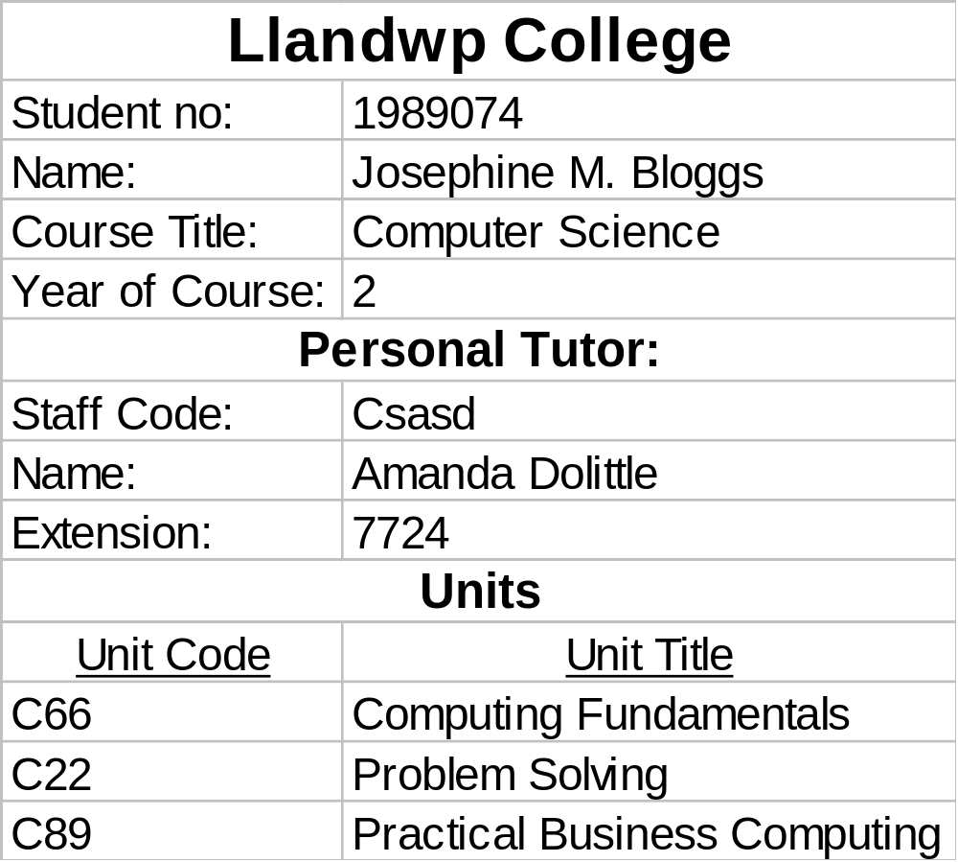
Analysing a Document
Suppose we are working with a registration card for Llandwp College

Slide 7
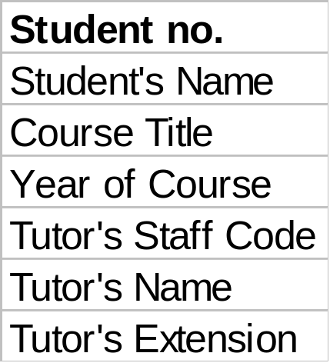
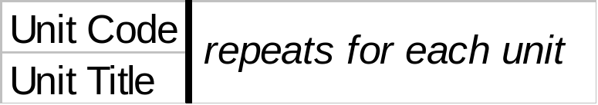
An Un-normalised Structure
As an initial step, the document is represented as an un-normalised structure:

Slide 8
Functional Dependencies and Enterprise Rules
Next, functional dependencies between the data fields are recorded
Functional dependencies are determined by enterprise rules for the data in question

Slide 9
Functional Dependencies
Student no. ➔
Student's Name, Course title, Year of Course, Tudor's Staff Code, Tutor's Name, Tutor's Extension
Tutor's Staff Code ➔
Tutor's Name, Tutor's Extension
Unit Code ➔
Unit Title
?

Slide 10
First Normal Form
The un-normalised structure is brought to first normal form by transferring repeating groups of items to separate relation schemes
Each new scheme includes the key of the original un-normalised structure as part of its own key

Slide 11
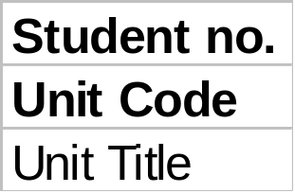
First Normal Form
?

Slide 12
Second Normal Form
The relation schemes are brought to second normal form by eliminating partial dependencies on keys
Unit Title is only partially dependent on the key (Student no., Unit Code), since Unit Code alone is sufficient to determine its value for any unit

Slide 13

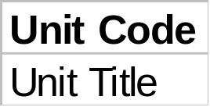
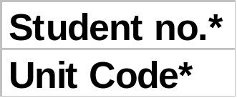
Second Normal Form
?

Slide 14
Bringing Relation Schemes to Third Normal Form
The relation schemes are brought to third normal form by eliminating transitive dependencies on keys
Tutor's Name and Tutor's Extension are transitively dependent on the key, Student no

Slide 15
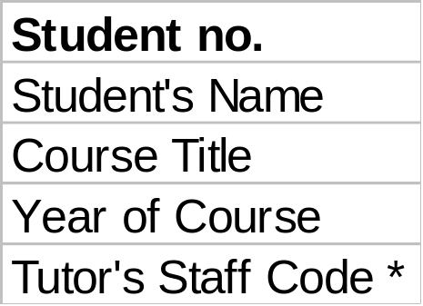
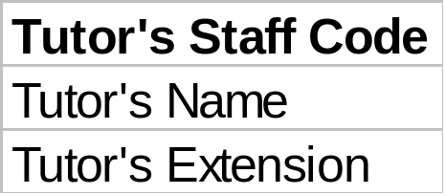
Third Normal Form
?

Slide 16
Summary of the normalisation procedure
Represent the source document as an un-normalised structure
Identify functional dependencies between data items
Construct first normal form schemes by eliminating repeating groups of data items
Bring the schemes to second normal form by eliminating partial dependencies on key fields
Bring the schemes to third normal form by eliminating transitive dependencies on key fields

Slide 17
More documents from the Llandwp College
Included are copies of
  a list of Course Units
  a list of Staff Teaching Duties
  a Timetable
As a systems analyst, it is your job to analyse these documents
  like the Registration Card was analysed above

Slide 18
The List of Course Units
Representing the Course Units list as an "un-normalised" structure gives:
The only functional dependency between these items is
  Unit Code ➔ Unit Title
This corresponds to the enterprise rule
  Each unit has a unique unit code which determines its title

Slide 19
Analysing the List of Course Units
In this case, the “un-normalised” structure is already in third normal form
  It contains
    no repeating groups of data items,
    no partial dependencies on key fields, and
    no transitive dependencies on keys.
  It needs no further analysis, and the resulting relation scheme is, as before:

Slide 20
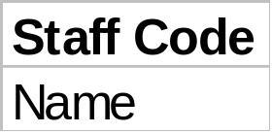
The List of Teaching Duties
Un-normalised Structure:
Enterprise Rule:
  Each member of staff has a unique staff code.
Functional dependency:
  Staff code ➔ Name

Slide 21
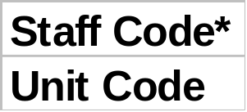
Analysing the list of Teaching Duties
First Normal Form
  Eliminate repeating groups of data items by moving the items in question to a new relation scheme, and including the key of the original scheme in that of the new scheme
These schemes are also in third normal form.

Slide 22
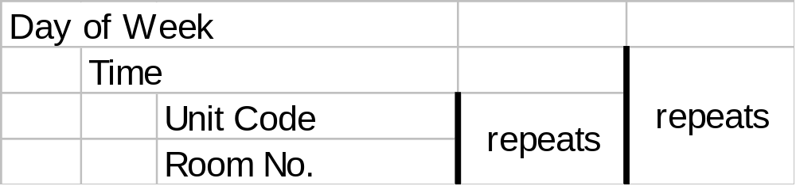
Analysing the Timetable
Un-normalised Structure:

Slide 23
Analysing the Timetable
Enterprise Rules:
  Only one unit can be taught in a given room at a given time on a given day of the week.
  Days of the week are unique, and lecture times on any given day are unique
Functional Dependencies:
  Day of Week, Time, Room No. ➔
  Unit Code
  Day of Week, Time, Unit Code ➔
  Room No.

Slide 24

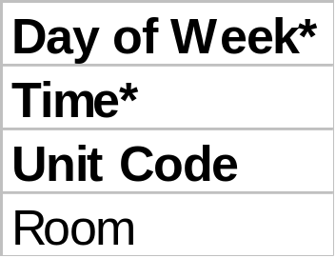
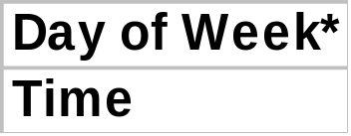
Analysing the Timetable
First Normal Form:
These schemes are also in third normal form.

Slide 25
The Complete Set of Normalised Relation Schemes
From the Student Registration Card:
  4 relations
From the Course Units List:
  1 relation
From the Teaching Duties List:
  2 relations
From the Timetable:
  3 relations

Slide 26
Optimising the Normalised Relation Schemes
Check attribute names for consistency, renaming attributes where necessary
Merge schemes that have the same key if they represent the same real world entity
Do not merge schemes that have the same key if one represents a subset domain of the other
Eliminate key-only schemes unless they represent information that you want to store in tables

Slide 27
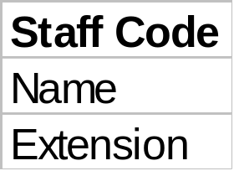
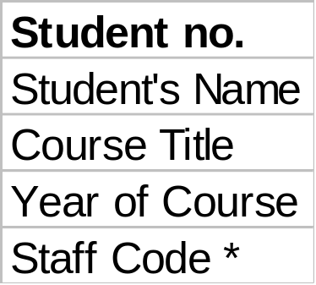
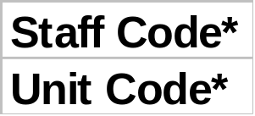
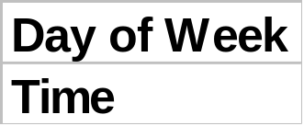
The Optimised Normalised Relation Schema

Slide 28
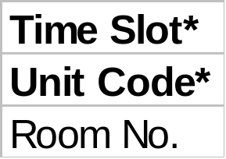
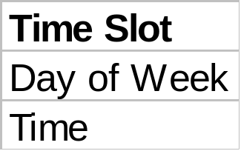
Further Optimised Normalised Relation Schema

Slide 29
Summary of Relation Schema
STAFF(Staff Code, Name, Extension)
STUDENT(Student no., Course Title, Year of Course, Tutor's Staff Code*)
  Tutor's Staff Code references STAFF
UNIT(Unit Code, Unit Title)
ENROL(Student no.*, Unit Code*)
  Student no. references STUDENT
  Unit Code references UNIT
TEACH(Staff Code*, Unit Code*)
  Staff Code references STAFF
TIME(Time Slot, Day of Week, Time)
  ALTERNATE KEY: (Day of Week, Time)
T_TABLE(Time Slot*, Unit Code*, Room No.)
  Time Slot references TIME
  Unit Code references UNIT

Slide 30
Summary
Rigorous, bottom-up data analysis entails
  collecting source documents
  drawing up un-normalised structures
  normalising these - 3NF, BCNF, 4NF ...
  optimising the resulting set of schemes
The resulting set defines the structure of the database that is to be constructed

Slide 31
Practical Combination
creative top-down design
rigorous bottom-up design
merger of top down and bottom up designs
  iteration

